Slide 1
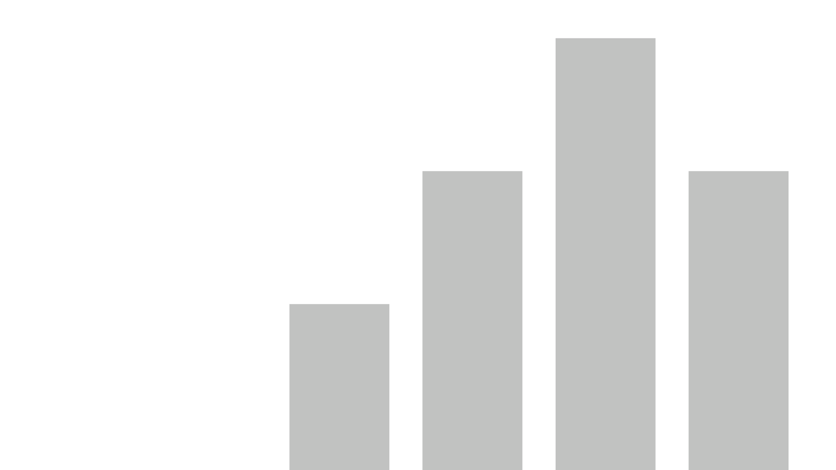


Mental Health Analysis New
View in Power BI
Last data refresh:
4/23/2024 1:34:52 AM UTC
Downloaded at:
4/23/2024 1:37:39 AM UTC

Slide 2
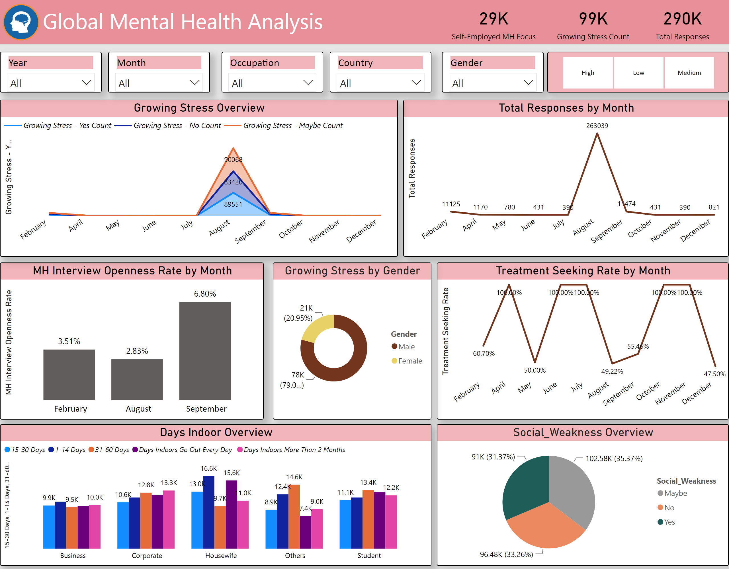
Global Mental Health
Notes:
lineChart
No alt text provided
card
No alt text provided
lineChart
No alt text provided
card
No alt text provided
Growing Stress by Gender
No alt text provided
columnChart
No alt text provided
Growing Stress Overview
No alt text provided
Days Indoor Overview
No alt text provided
Social_Weakness Overview
No alt text provided
textbox
No alt text provided
card
No alt text provided
slicer
No alt text provided
slicer
No alt text provided
slicer
No alt text provided
slicer
No alt text provided
slicer
No alt text provided
slicer
No alt text provided
image
No alt text provided

Slide 3
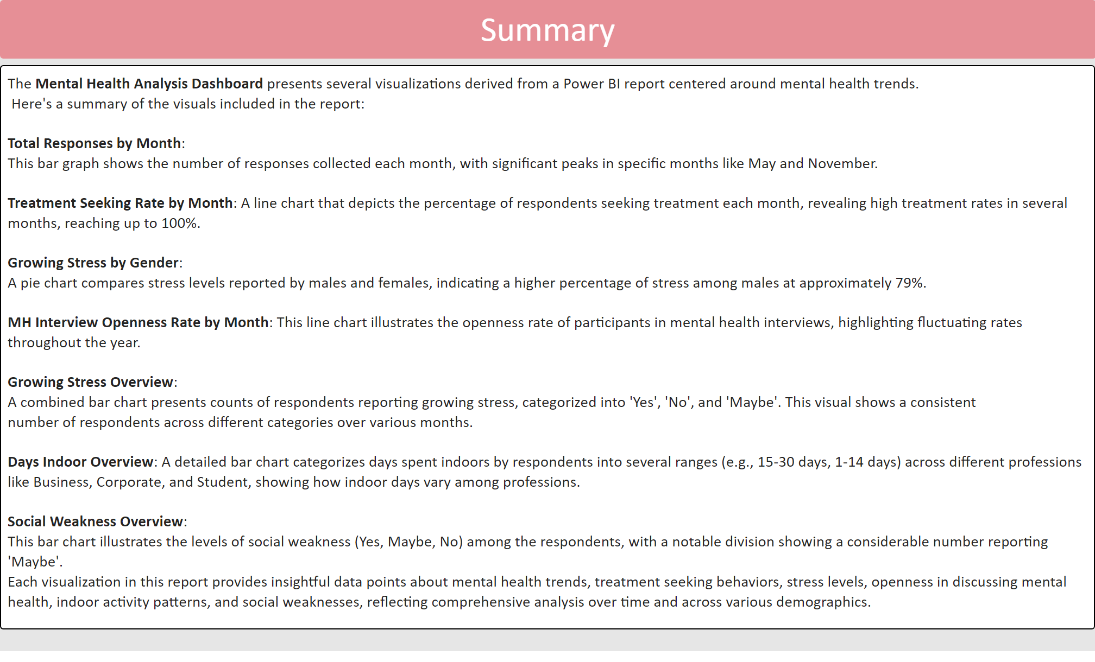
Summary
Notes:
textbox
No alt text provided
textbox
No alt text provided

